Slide 1

Notes:
Note:
This is a simple round rectangle that can represent some process, operation, or transformation
Author: Elvis Saravia

Slide 2




BERT
labels
Softmax
Linear layer
BERT
CLS
W1
E1
Wi
E2
Wj
Wn
Notes:
Note:
These visuals could represent transformations (left) or operations (right)
The visuals on the right use the Math Equations Add on for Google Slides. You won’t be able to directly modify the equation here. Install the add on and just generate the operation that you need.
Author: Elvis Saravia

Slide 3
0.02
0.3
0.23
0.65
0.04
肝
0.62
0.87
0.09
0.23
0.67
未
0.81
0.05
0.03
0.72
0.54
见
0.47
0.86
0.19
0.97
0.49
异
常
0.41
0.35
0.38
0.19
0.88
Notes:
Note:
Can represent a multidimensional array (2D)
Author: Elvis Saravia

Slide 4
Notes:
Note:
Can represent a multidimensional array (2D)
Author: Elvis Saravia

Slide 5
Notes:
Note:
These visuals can represent a multi-directional array (3D)
Author: Elvis Saravia

Slide 6
output
input
Notes:
Note:
This diagram could represent a simple logistic regression model; you can generalize to deep neural network by adding layers (see next slide)
Author: Elvis Saravia

Slide 7
Notes:
Note:
1 hidden layer neural network
Author: Elvis Saravia

Slide 8
Softmax
Linear
Add & Norm
Feed
Forward
Add & Norm
Feed
Forward
Add & Norm
Multi-Head
Attention
Add & Norm
Multi-Head
Attention
Add & Norm
Masked
Multi-Head
Attention
Positional
Encoding
Input
Embedding
Positional
Encoding
Inputs
Output
Embedding
Outputs (shifted right)
Notes:
Note:
Using the same visual components from before and a few new custom ones, I was able to come up with the Transformer architecture
This is a reproduction of the Transformer architecture figure presented in the work of Vaswani et al. 2017
You can further customize it however you want
Author: Elvis Saravia

Slide 9
肝脏
形态大小正常
轮廓规则
writing
Tokenize
“肝脏形态大小正常，轮廓规整，未见异常密度影；”
Notes:
Note:
This figure aims to demonstrate the process of tokenization
If you want to change the gradient colors of this shape, you can simply click on the shape and then select “Fill color” (the bucket looking icon at the top).
This is a gradient color so you can customize however you want
Author: Elvis Saravia

Slide 10
Size
Family?
X
Y
#bed
Walk?
PRICE ŷ
Basic Neuron Model
ZIP
School
How does NN work (Coursera)
Wealth
Ŷ = 0
X
Logistic Regression
Ŷ = 1
Notes:
By @srvmshr

Slide 11
$
$
ReLU(x)
Size
Size
Linear regression
256
225
56
.
.
.
214
210
211
NxN
NxN
NxN
NxN
R-G-B
Notes:
By @srvmshr

Slide 12
256
225
56
.
.
.
214
210
211
NxN
NxN
NxN
NxN
R-G-B
Unrolling Feature vectors
Notes:
By @srvmshr

Slide 13
Large NN
Med NN
η
Small NN
SVM,LR etc
Amount of Data
Why does Deep learning work?
Notes:
By @srvmshr

Slide 14
Hidden
Input
Output
a^{[1]}₁
a^{[1]}₂
One hidden layer neural network
X
a^{[2]}
Ŷ
a^{[1]}₃
a^{[1]}₄
X = A^{[0]}
A^{[1]}
A^{[2]}
Notes:
By @srvmshr

Slide 15
a^{[1]}₁
x_{[1]}
a^{[2]}
a^{[1]}₂
x_{[2]}
x_{[1]}
x_{[2]}
x_{[3]}
Neural network templates
Notes:
By @srvmshr

Slide 16
Train
Valid
Test
Underfitting
Good fit
Overfitting
x2
x2
x2
x1
x1
x1
Train-Dev-Test vs. Model fitting
Notes:
By @srvmshr

Slide 17
x_{[1]}
x_{[2]}
a_{[L]}
DropOut
x_{[3]}
x2
r=1
x2
Normalization
x1
x1
Notes:
By @srvmshr

Slide 18
J
w2
Early stopping
Err
w1
w1
w2
Before Normalization
Dev
Train
it.
J
w2
w1
w1
After Normalization
w2
Notes:
By @srvmshr

Slide 19
x₁
x₂
w[L]
w[1]
w[2]
w[L-2]
w[L-1]
Deep neural networks
FN
TN
TP
FP
Understanding
Precision & Recall
Notes:
By @srvmshr

Slide 20
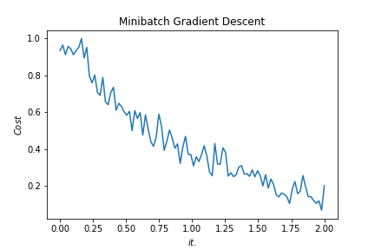
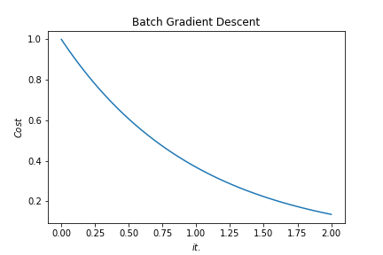
Batch vs. Mini-batch Gradient Descent
w2
w2
BGD
SGD
Mini-batch Gradient Descent vs. SGD
SGD
w1
w1
Notes:
By @srvmshr

Slide 21
x_{[1]}
p_{[1]}
x_{[2]}
p_{[2]}
x_{[3]}
Softmax Prediction with 2 outputs
Notes:
By @srvmshr

Slide 22
3
16+32
16
16
16
16
1
Convolution 3x3
Convolution 1x1
Dropout 0.1
Max Pooling 2x2
Skip connection
Dropout 0.2
Up Sampling 2x2
Block copied
Dropout 0.3
32
32
32+64
32
64
64
64+128
64
128
128
128+256
128
256
256
Notes:
By @avsthiago

Slide 23
Input:
(None, size, size, 3)
InputLayer
Output:
(None, size, size, 3)
Inception-v3 architecture
Input:
(None, 14, 14, 2048)
GlobalAveragePooling2D
Output:
(None, 2048)
Input:
(None, 2048)
Dense
Activation
ReLU
Output:
(None, 1024)
Input:
(None, 1024)
Dense
Activation
Softmax
Output:
(None, 7)
Notes:
By @avsthiago

Slide 24
Layer1
Layer2
Layer3
Layer4
Input
Conv
Max-Pool
Conv
Max-Pool
FC
FC
Softmax
Layer1
Layer2
Layer3
Layer4
Layer5
Layer6
Layer7
Layer8
Input
Conv
Max-Pool
Conv
Max-Pool
Conv
Conv
Conv
Max-Pool
FC
FC
FC
Softmax
Notes:
By @avsthiago

Slide 25
Filter concatenation
3x3 convolutions
5x5 convolutions
1x1 convolutions
1x1 convolutions
1x1 convolutions
1x1 convolutions
3x3 max pooling
Previous layer
Notes:
By @avsthiago

Slide 26
Avg-Pool
Auxiliary Classifier
Conv
FC
FC
Softmax
Inception
Input
Inception
Conv
Max-Pool
Conv
Max-Pool
Conv
Max-Pool
Inception
Inception
Max-Pool
Inception
Inception
Inception
Inception
Inception
Max-Pool
Avg-Pool
Conv
FC
Softmax
Avg-Pool
Auxiliary Classifier
Conv
FC
FC
Softmax
Notes:
By @avsthiago

Slide 27
Filter concatenation
Filter concatenation
3x3 conv.
1x3 conv.
3x1 conv.
1x1 conv.
3x3 conv.
3x3 conv.
1x1 conv.
1x3 conv.
3x1 conv.
3x3 conv.
1x1 conv.
1x1 conv.
Pool
1x1 conv.
1x1 conv.
Pool
1x1 conv.
1x1 conv.
Previous layer
Previous layer
(a)
(b)
Notes:
By @avsthiago

Slide 28
Previous input
Previous input
x
x
F(x)
F(x)
Stacked layers
Stacked layers
x
identity
+
y=F(x)
y=F(x)+x
R1
R1
R2
R1
R1
R2
R3
R1
R2
R3
Notes:
By @avsthiago

Slide 29
Dense Block 1
Dense Block 2
Dense Block 3
Softmax
FC
Avg-Pool
Avg-Pool
Conv
Conv
Input
Avg-Pool
Conv
Transition layers
Notes:
By @avsthiago

Slide 30
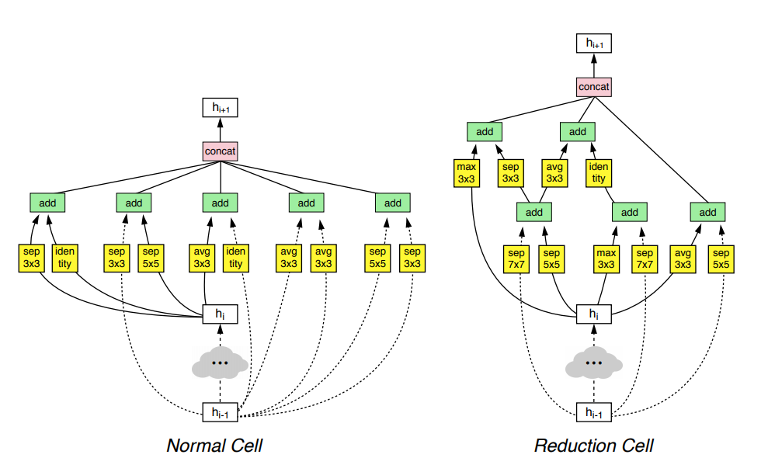
h_{i+1}
Filter concatenation
h_{i+1}
add
add
Filter concatenation
3x3 max
3x3 conv
3x3 avg
identity
add
add
add
add
add
add
add
add
3x3 conv
identity
3x3 conv
5x5 conv
3x3 avg
identity
3x3 avg
3x3 avg
3x3 conv
5x5 conv
7x7 conv
5x5 conv
3x3 max
7x7 conv
3x3 avg
5x5 conv
h_{i}
h_{i}
...
...
h_{i-1}
h_{i-1}
(a)
(b)
Notes:
By @avsthiago

Slide 31
Notes:
By @avsthiago

Slide 32
关系类别
注意力机制 Attention
Attention 层
BiLSTM层
词嵌入层
字嵌入+实体位置信息

Slide 33
B-L
I-L
B-F
I-F
CRF层
P1
P2
P3
P4
LSTM层输出
双向LSTM层
字嵌入+分词特征
肝
裂
增
宽

Slide 34
input
projection
output
W(t-2)
W(t-1)
W(t)
W(t+1)
W(t+2)
Skip-gram模型

Slide 35
Max(1,1,5,6) = 6
Y
1
1
2
4
5
6
7
8
6
8
3
2
1
0
Pooling performed with a 2x2 kernel and a stride of 2
3
4
1
2
3
4
X
Image Representation
Notes:
By @avsthiago

